Slide 1
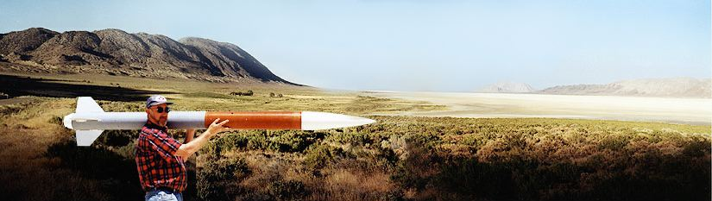
Fall Term Progress Report
CS Capstone Team 27
Client: Nancy Squires
Team member: Steven Silvers, Paul Minner,
Zhaolong Wu, Zachary DeVita

Slide 2

Project Overview
What is ARLISS?
A Rocket Launch for International Student Satellites
International payload design
competition in
Black Rock, Nevada ------------------>
Created by a professor of Stanford in 1999
What is the goal of ARLISS?
Design, integrate, fly, and analyze
data of a space experiment for
low Earth orbit and recovery
Teach the complete collaborative design process

Slide 3
Introduction
The Team:
Collaboration between ME, CS, and ECE students
ME designs structures, subsystems, and functionality
ECE implements electrical hardware
CS develops software to enable autonomous functions
Past OSU involvement:
None!
2017 ARLISS competition will mark OSU’s first participation

Slide 4
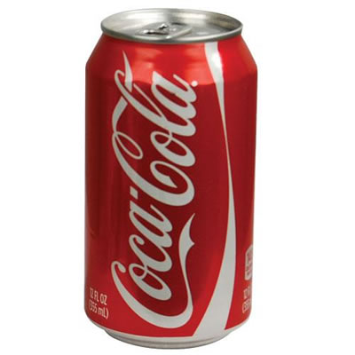
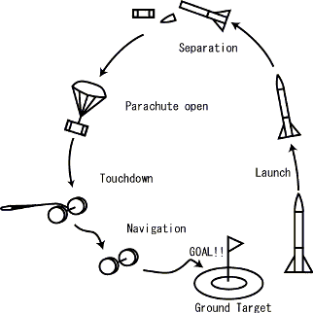
Requirements
CanSat Requirements:
Fit inside and weigh less than a soda can
Hence the term “CanSat”
4.8’’ length and 2.6’’ diameter
Maximum weight of 350 grams
Deploy from rocket at apogee
10,000 - 12,000 ft.
Land safely
Travel to GPS coordinate autonomously
Will need to physically touch target marker

Slide 5
Project Challenges:
Strict weight and size restrictions : 350 grams and standard 12oz. Soda can
Autonomous operation and navigation
Must reach GPS location and touch physical marker
Variable distance to target
Wind causes unpredictable drift, last year one team’s satellite was blown away 14 kilometers.
Difficult terrain features
Parachute entanglement
Parachute can still present obstacle after descent

Slide 6
Week 3: Progress
Finalized project team assignment.
Meet the team.
Meet and had a brief discussion with the client.
Meet the extended teams, electrical and mechanical engineers.
Problem Statement
Establish a problem, giving potential solution to the problem.

Slide 7
Week 3: Plan
Address the problem
Giving the problem potential solutions

Slide 8
Week 3: Problems
It’s an open project, so our client gives us the complete freedom on regarding designing approach of the project.
Leaves us with no expertise or direction for the project.

